Slide 1
Greek Yogurt New Flavor Recommandation
MSMA GROUP 11
Qianyu Dong | Sichun Li
Xinbei Jin | Jerry Shen | Xiao Shi

Slide 2
Predictive Methodology
Goal
After basic data exploration, we found that customer have preferable flavors for Greek yogurt, while there is no obvious difference between flavors of Regular yogurt. Thus, it is wise to focus on Greek yogurt to launch new flavors. Our goal is to figure out the optimal new flavor sets by analysis.
Data
Analysis
Recommendation
System Data
Sales
flavors having good sales performance
New flavor sets
reaching broad customers
popular items and leading to sales increase
Survey Data
TURF
flavor sets achieving the highest reach
Preference
flavors bought by customers frequently

Slide 3




Key Insights
KEY INSIGHTS
Pineapple, Black Cherry, Lemon and Raspberry should be the next flavors to launch.
Our recommended four flavors sold well in Greek yogurt market, ranking 1st, 2nd, 3rd and 6th.
The existing flavors already let us enjoy a 97.68% reach, while these four flavors can further bring up reach by 2%.
In addition to the flavors we have, consumers would buy our recommended flavors frequently.

Slide 4
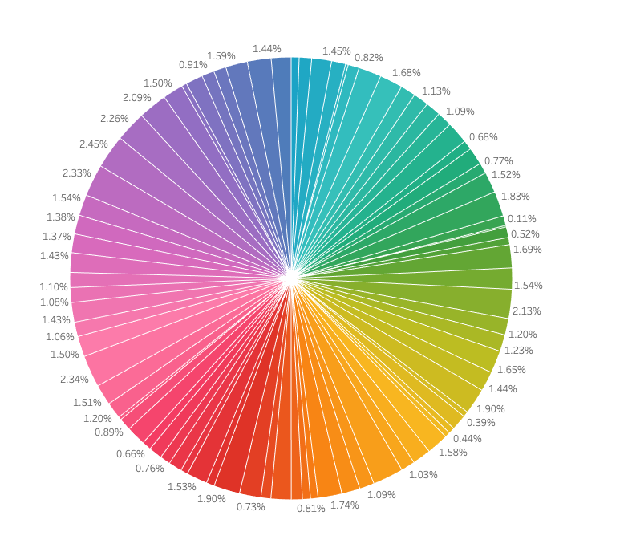
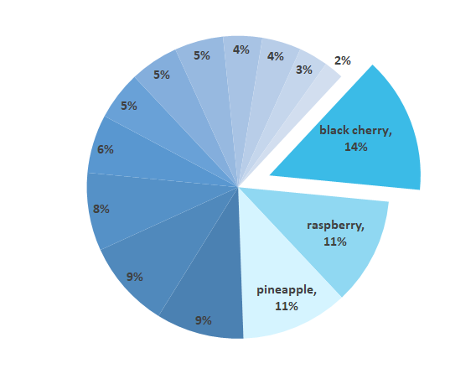
Flavor leads to greater difference in sales for greek yogurt than regular yogurt
Greek Yogurt Weekly Sales by Flavor
Regular Yogurt Weekly Sales by Flavor
Lemon
Source: Loyalty Card System, see details in Appendix A

Slide 5
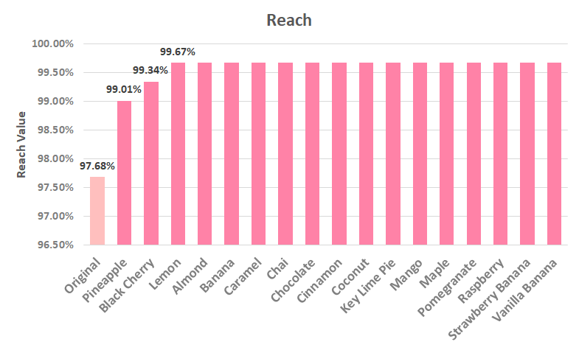
TURF Analysis
Launching Pineapple, Black Cherry and Lemon flavors can cover the most potential consumers.
Concern:
TURF Analysis didn’t consider differences among purchase frequency.
Source: Consumer Survey Data; Sample Size = 618

Slide 6
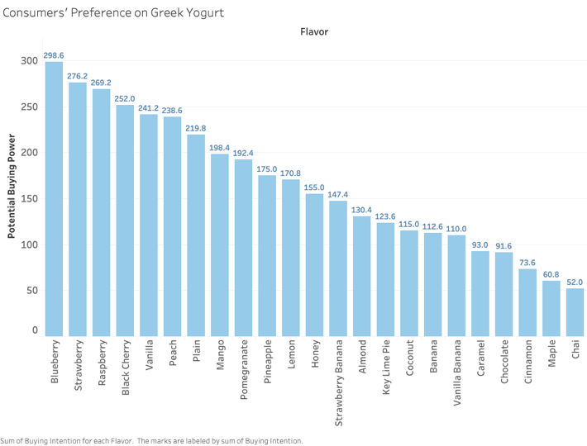
Consumer Preferences on Flavors (Survey)
Assumption:
Frequency | Weight
Regularly | 0.8
Occasionally | 0.2
Never | 0
NA | Ignored
Besides current flavors, Raspberry is the No.1 flavor consumers choose in the survey.
Source: Consumer Survey Data; Sample Size = 618, see details in Appendix B
*Potential Buying Power = sum( Number of consumers of different frequency*weight)

Slide 7
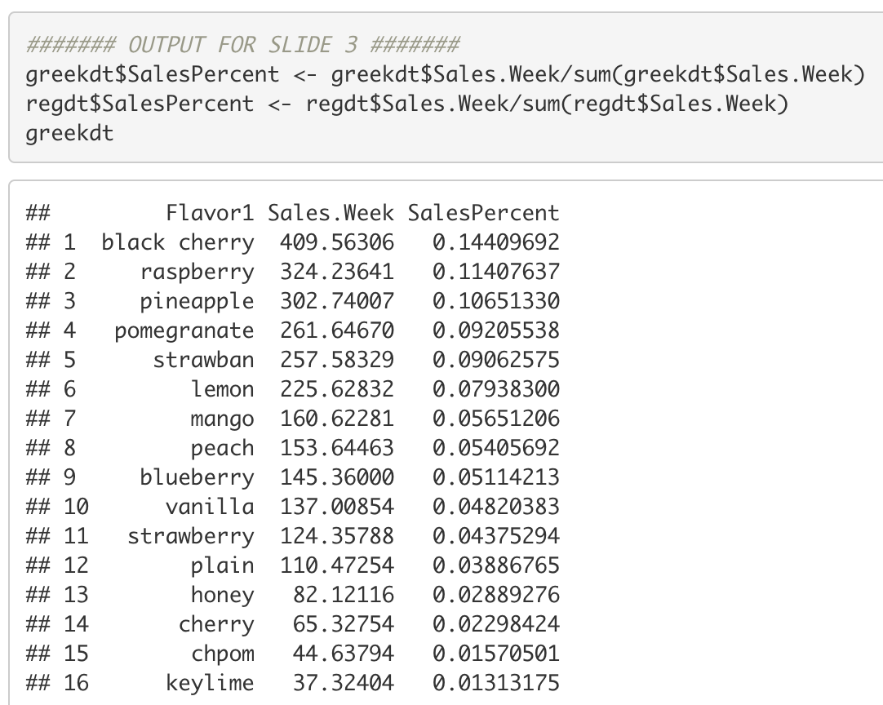
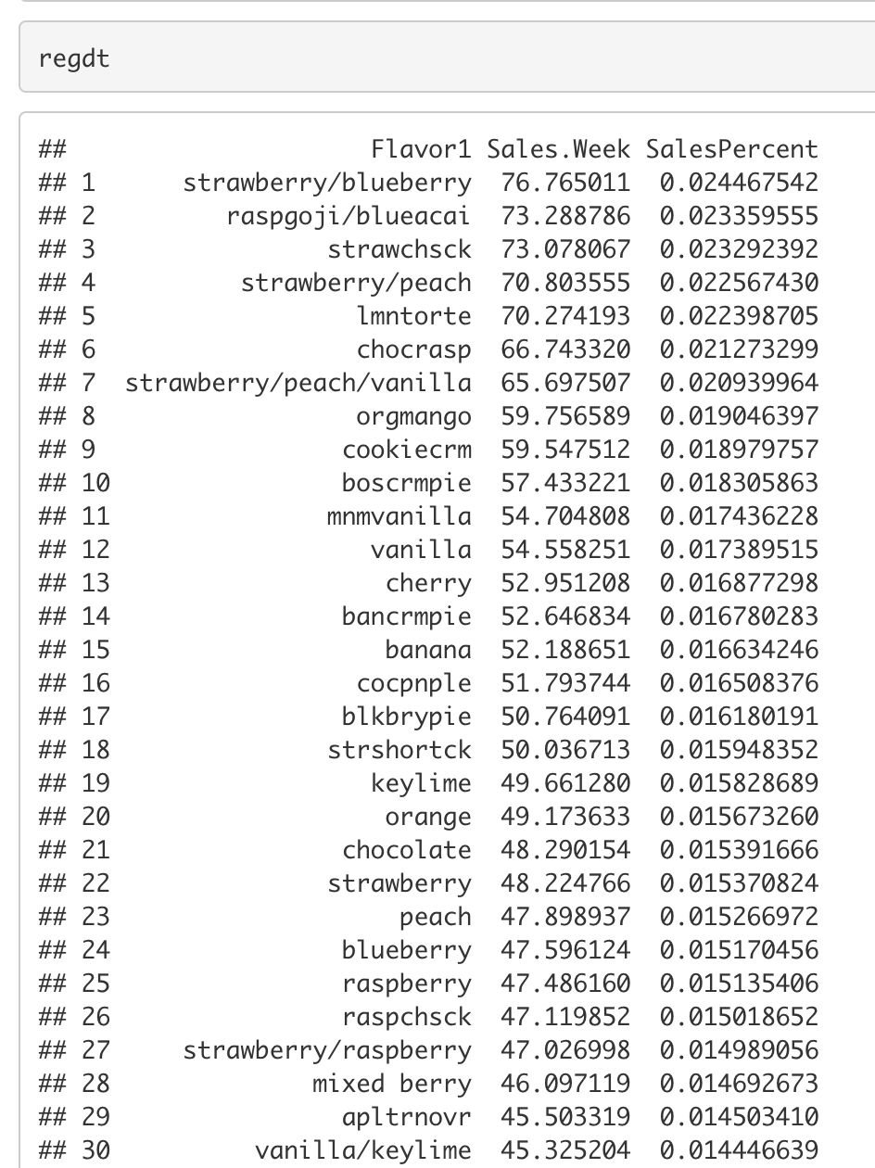
Appendix A - Sales Percentage Calculation

Slide 8
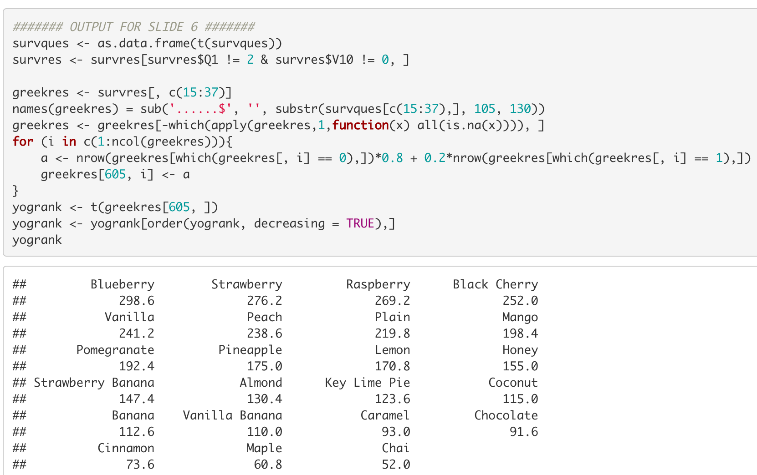
Appendix B - Consumer Preferences Analysis (Survey)

